Slide 1

Problems on MGF 2010

Slide 2
Reference
Data
Youtube
Code

Slide 3
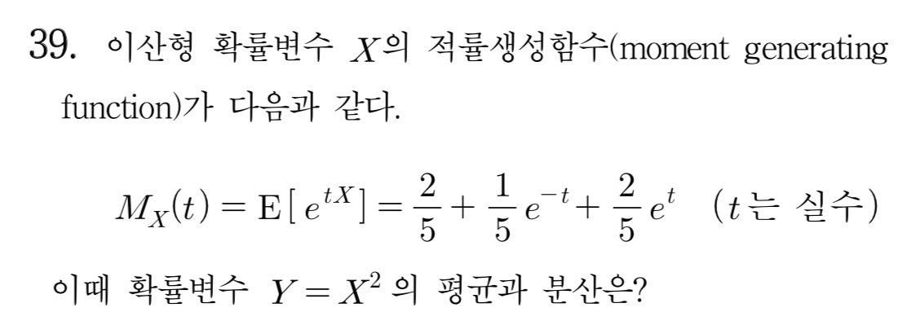
[2010]

Slide 4
